Slide 1
QF602: Derivatives
Lecture 4: Option Pricing Models

Slide 2
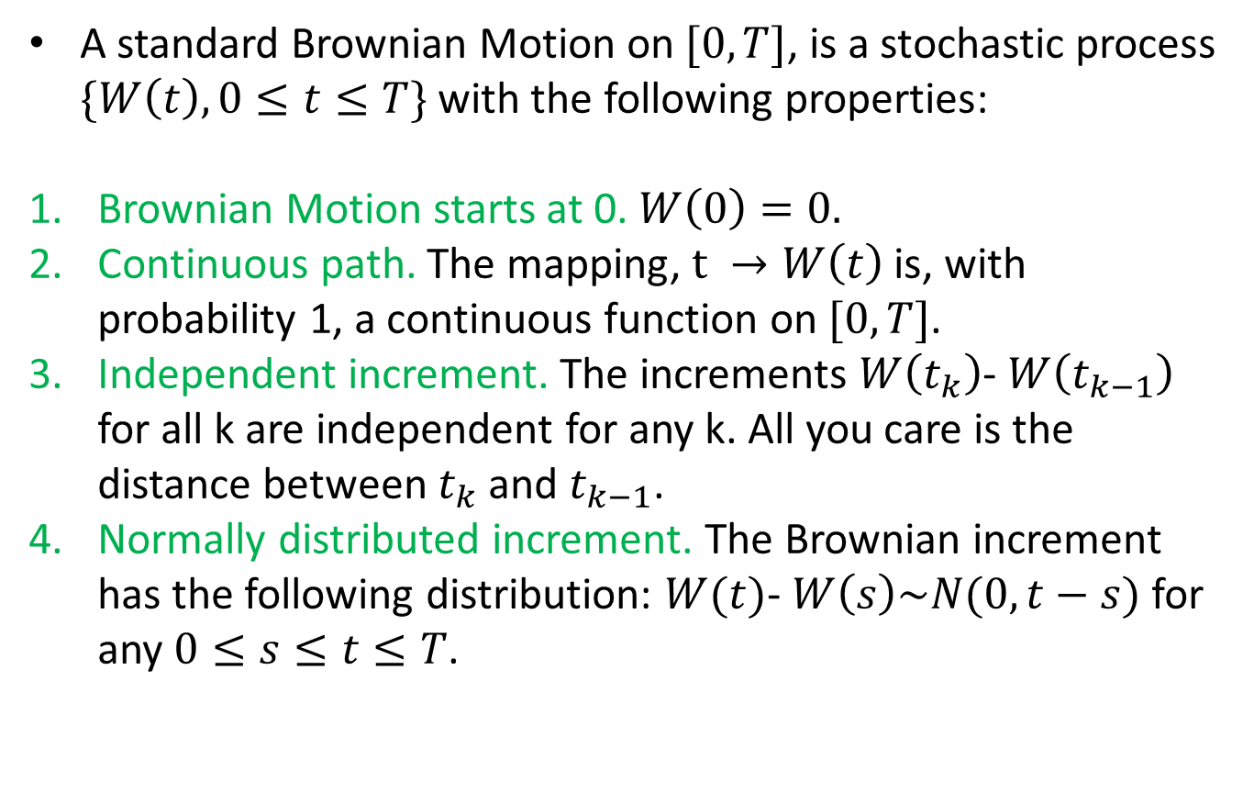
Brownian Motion
A standard Brownian Motion on $[0,T]$, is a stochastic process $\{W\left(t\right),0≤t≤T\}$ with the following properties:
Brownian Motion starts at 0.$W\left(0\right)=0.$
Continuous path. The mapping, $t →W\left(t\right)$ is, with probability 1, a continuous function on $[0,T]$.
Independent increment. The increments $W\left(t_{k}\right)$- $W\left(t_{k−1}\right)$ for all k are independent for any k. All you care is the distance between $t_{k}$ and $t_{k−1}$.
Normally distributed increment. The Brownian increment has the following distribution: $W(t)$- $W\left(s\right)\sim N(0,t−s)$ for any $0≤s≤t≤T$.

Slide 3
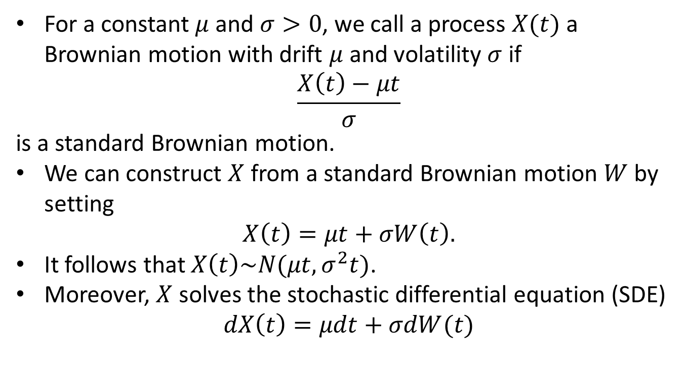
Brownian Motion with Drift
For a constant $μ$and $σ>0$, we call a process $X(t)$ a Brownian motion with drift $μ$ and volatility $σ$ if
$$\frac{X\left(t\right)−μt}{σ}$$
is a standard Brownian motion.
We can construct $X$ from a standard Brownian motion $W$ by setting
$X\left(t\right)=μt+σW\left(t\right).$
It follows that $X\left(t\right)\sim N(μt, σ^{2}t)$.
Moreover, $X$ solves the stochastic differential equation (SDE)
$$dX\left(t\right)=μdt+σdW(t)$$

Slide 4
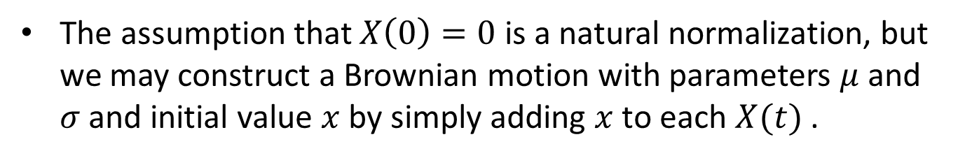
Brownian Motion with Drift
The assumption that $X\left(0\right)=0$ is a natural normalization, but we may construct a Brownian motion with parameters $μ$ and $σ$ and initial value $x$ by simply adding $x$ to each $X(t)$ .

Slide 5
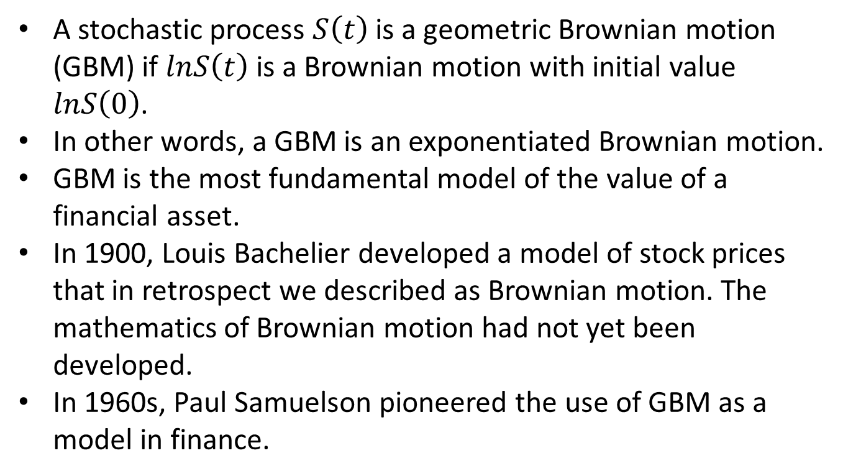
Geometric Brownian Motion
A stochastic process $S\left(t\right)$ is a geometric Brownian motion (GBM) if $lnS\left(t\right)$ is a Brownian motion with initial value $lnS\left(0\right)$.
In other words, a GBM is an exponentiated Brownian motion.
GBM is the most fundamental model of the value of a financial asset.
In 1900, Louis Bachelier developed a model of stock prices that in retrospect we described as Brownian motion. The mathematics of Brownian motion had not yet been developed.
In 1960s, Paul Samuelson pioneered the use of GBM as a model in finance.

Slide 6
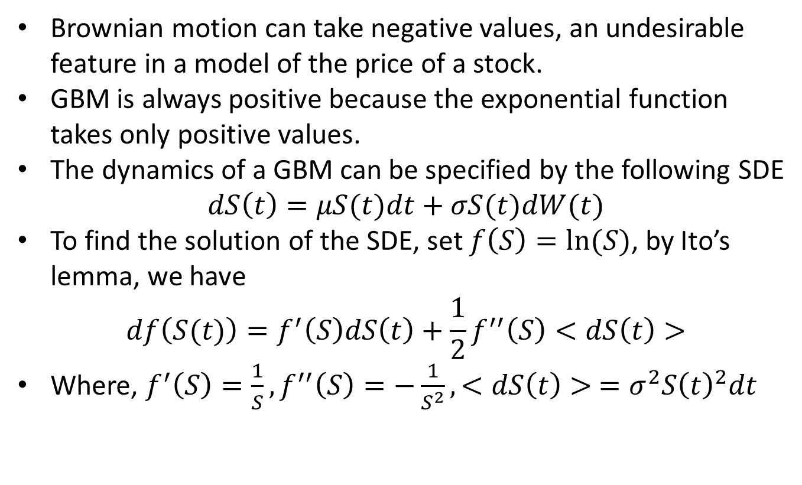
Geometric Brownian Motion
Brownian motion can take negative values, an undesirable feature in a model of the price of a stock.
GBM is always positive because the exponential function takes only positive values.
The dynamics of a GBM can be specified by the following SDE
$$dS\left(t\right)=μS(t)dt+σS(t)dW(t)$$
To find the solution of the SDE, set $f\left(S\right)=ln⁡(S)$, by Ito’s lemma, we have
$$df\left(S(t)\right)=f^{′}\left(S\right)dS\left(t\right)+\frac{1}{2}f^{′′}\left(S\right)<dS\left(t\right)>$$
Where, $f^{′}\left(S\right)=\frac{1}{S}, f^{′′}\left(S\right)=−\frac{1}{S^{2}}, <dS\left(t\right)> =σ^{2}S{\left(t\right)}^{2}dt$

Slide 7
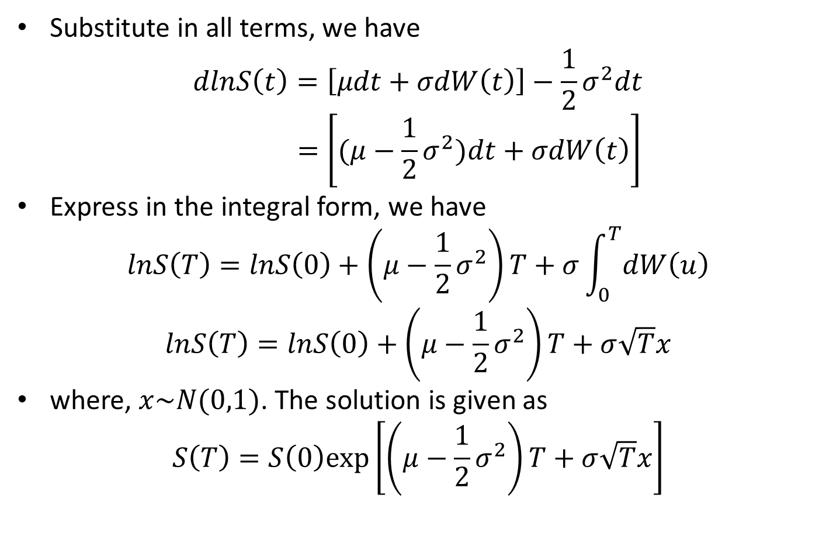
Geometric Brownian Motion
Substitute in all terms, we have
$$dlnS\left(t\right)=\left[μdt+σdW\left(t\right)\right]−\frac{1}{2}σ^{2}dt$$
$$=\left[(μ−\frac{1}{2}σ^{2})dt+σdW\left(t\right)\right]$$
Express in the integral form, we have
$$lnS\left(T\right)=lnS\left(0\right)+\left(μ−\frac{1}{2}σ^{2}\right)T+σ\int_{0}^{T}{dW\left(u\right)}$$
$$lnS\left(T\right)=lnS\left(0\right)+\left(μ−\frac{1}{2}σ^{2}\right)T+σ\sqrt{T}x$$
where, $x\sim N(0,1)$. The solution is given as
$$S\left(T\right)=S\left(0\right)exp⁡\left[\left(μ−\frac{1}{2}σ^{2}\right)T+σ\sqrt{T}x\right]$$

Slide 8
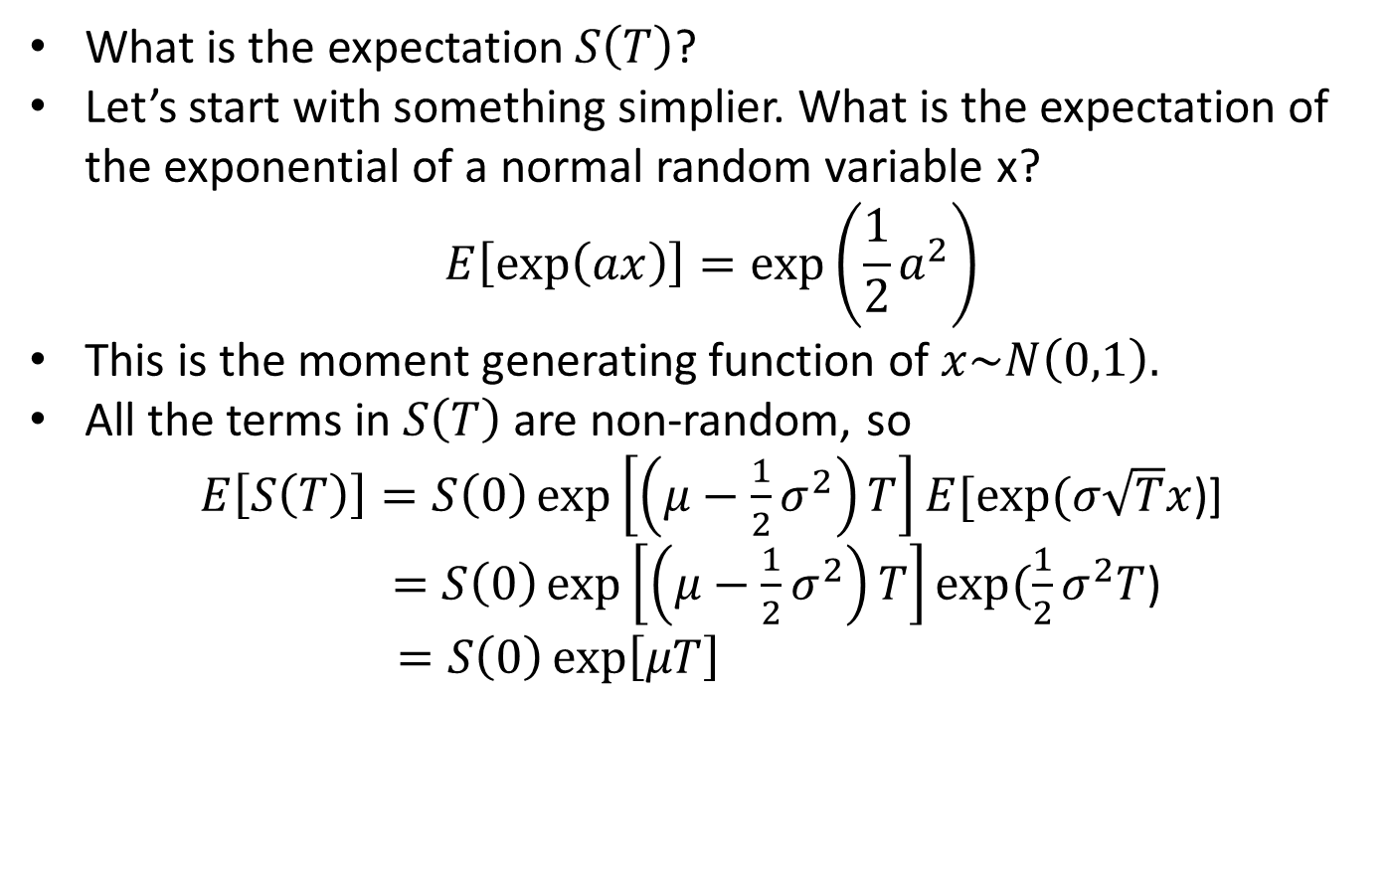
Geometric Brownian Motion
What is the expectation $S\left(T\right)$?
Let’s start with something simplier. What is the expectation of the exponential of a normal random variable x?
$$E\left[\exp\left(ax\right)\right]=\exp\left(\frac{1}{2}a^{2}\right)$$
This is the moment generating function of $x\sim N\left(0,1\right).$
All the terms in $S\left(T\right)$ are non-random, so
$E\left[S\left(T\right)\right]=S\left(0\right)\exp\left[\left(μ−\frac{1}{2}σ^{2}\right)T\right]E[exp⁡(σ\sqrt{T}x$)]
$=S\left(0\right)\exp\left[\left(μ−\frac{1}{2}σ^{2}\right)T\right]exp⁡(\frac{1}{2}σ^{2}T$)
$=S\left(0\right)\exp\left[μT\right]$

Slide 9
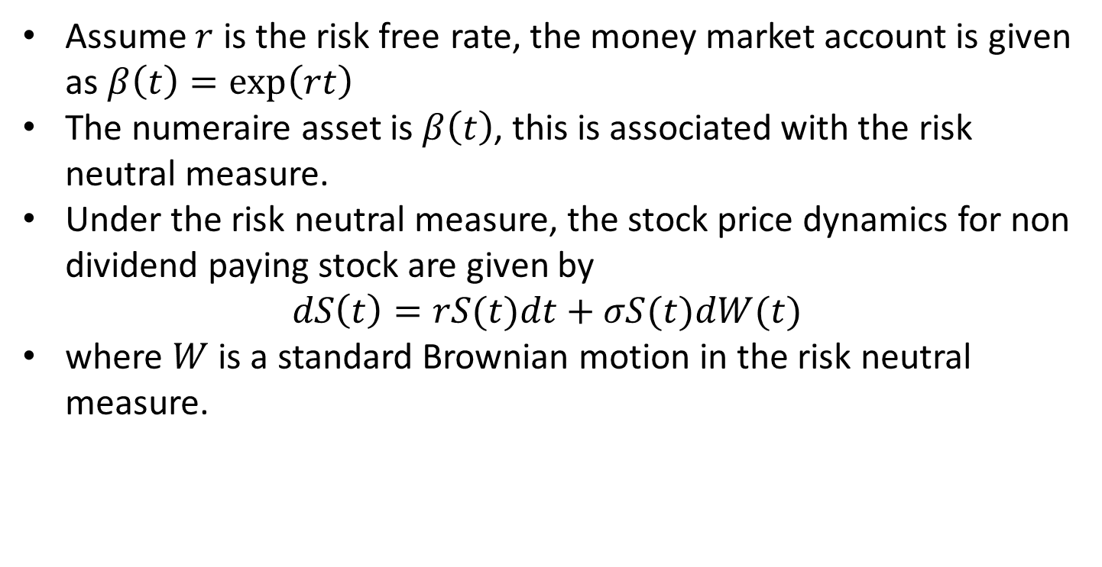
Black Scholes
Assume $r$ is the risk free rate, the money market account is given as $β\left(t\right)=\exp\left(rt\right)$
The numeraire asset is $β\left(t\right)$, this is associated with the risk neutral measure.
Under the risk neutral measure, the stock price dynamics for non dividend paying stock are given by
$$dS\left(t\right)=rS(t)dt+σS(t)dW(t)$$
where $W$ is a standard Brownian motion in the risk neutral measure.

Slide 10
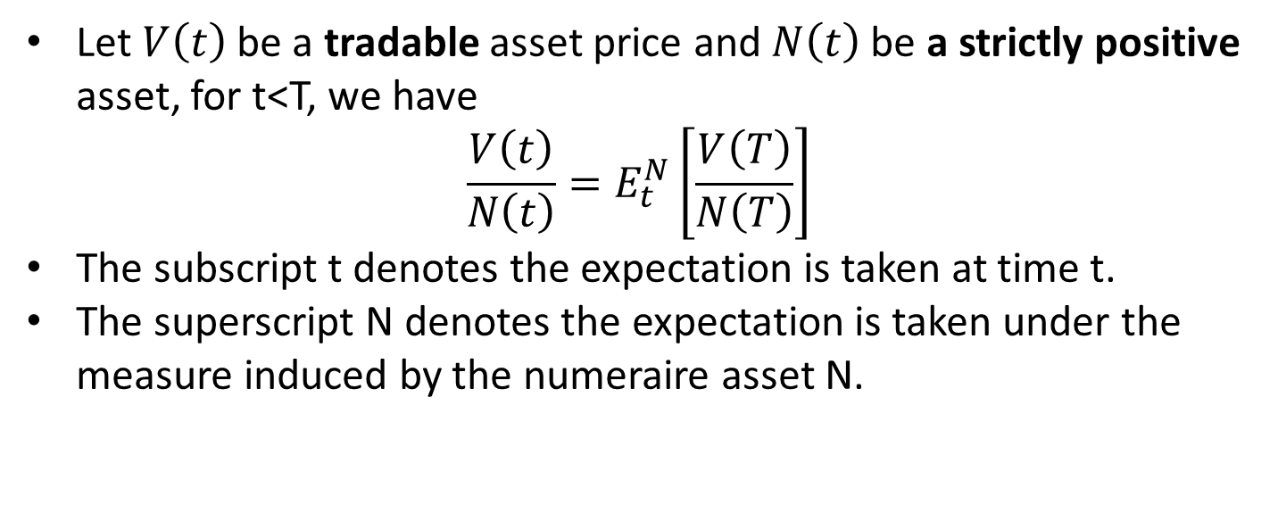
Martingale pricing
Let $V\left(t\right)$ be a tradable asset price and $N\left(t\right)$ be a strictly positive asset, for t<T, we have
$$\frac{V\left(t\right)}{N\left(t\right)}=E_{t}^{N}\left[\frac{V\left(T\right)}{N\left(T\right)}\right]$$
The subscript t denotes the expectation is taken at time t.
The superscript N denotes the expectation is taken under the measure induced by the numeraire asset N.

Slide 11
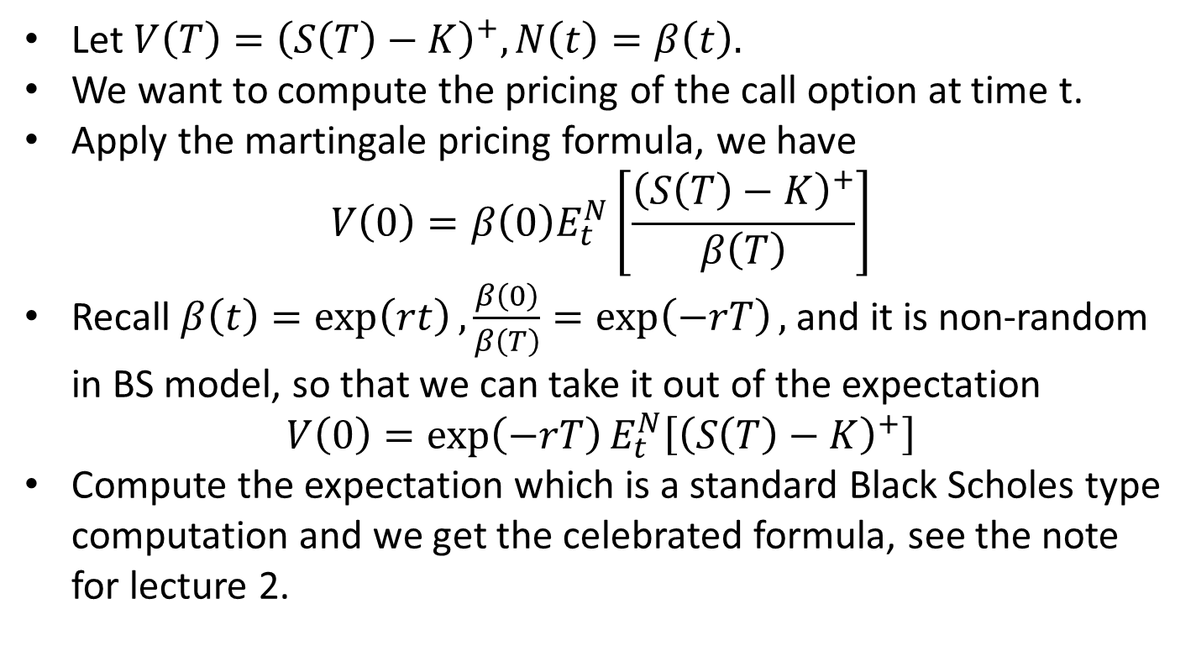
Pricing a call option in BS
Let $V\left(T\right)={\left(S\left(T\right)−K\right)}^{+}, N\left(t\right)=β\left(t\right).$
We want to compute the pricing of the call option at time t.
Apply the martingale pricing formula, we have
$$V\left(0\right)={β\left(0\right)E}_{t}^{N}\left[\frac{{\left(S\left(T\right)−K\right)}^{+}}{β\left(T\right)}\right]$$
Recall $β\left(t\right)=\exp\left(rt\right),\frac{β\left(0\right)}{β\left(T\right)}=\exp\left(−rT\right),$and it is non-random in BS model, so that we can take it out of the expectation
$$V\left(0\right)={\exp\left(−rT\right)E}_{t}^{N}\left[{\left(S\left(T\right)−K\right)}^{+}\right]$$
Compute the expectation which is a standard Black Scholes type computation and we get the celebrated formula, see the note for lecture 2.

Slide 12
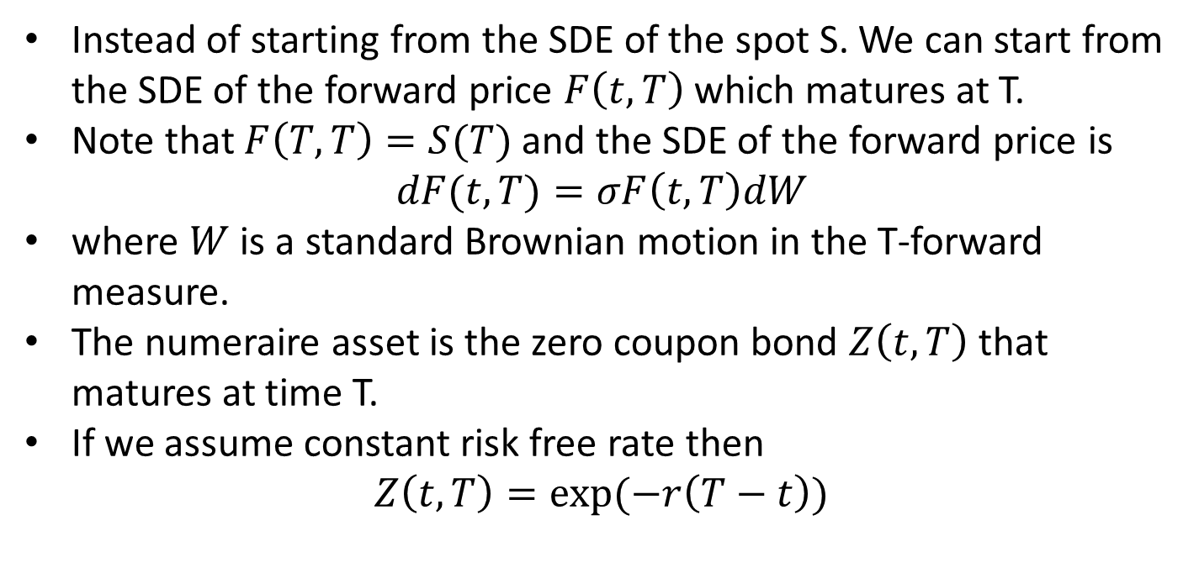
Another formulation
Instead of starting from the SDE of the spot S. We can start from the SDE of the forward price $F\left(t,T\right)$ which matures at T.
Note that $F\left(T,T\right)=S(T)$and the SDE of the forward price is
$$dF(t,T)=σF\left(t,T\right)dW$$
where $W$ is a standard Brownian motion in the T-forward measure.
The numeraire asset is the zero coupon bond $Z\left(t,T\right)$ that matures at time T.
If we assume constant risk free rate then
$Z\left(t,T\right)=exp⁡(−r\left(T−t\right))$

Slide 13
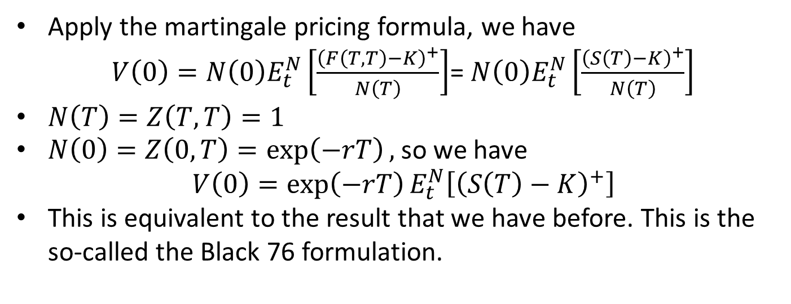
Another formulation
Apply the martingale pricing formula, we have
$V\left(0\right)={N\left(0\right)E}_{t}^{N}\left[\frac{{\left(F\left(T,T\right)−K\right)}^{+}}{N\left(T\right)}\right]$= ${N\left(0\right)E}_{t}^{N}\left[\frac{{\left(S\left(T\right)−K\right)}^{+}}{N\left(T\right)}\right]$
$N\left(T\right)=Z\left(T,T\right)=1$
$N\left(0\right)=Z\left(0,T\right)=\exp\left(−rT\right),$so we have
$$V\left(0\right)={\exp\left(−rT\right)E}_{t}^{N}\left[{\left(S\left(T\right)−K\right)}^{+}\right]$$
This is equivalent to the result that we have before. This is the so-called the Black 76 formulation.

Slide 14
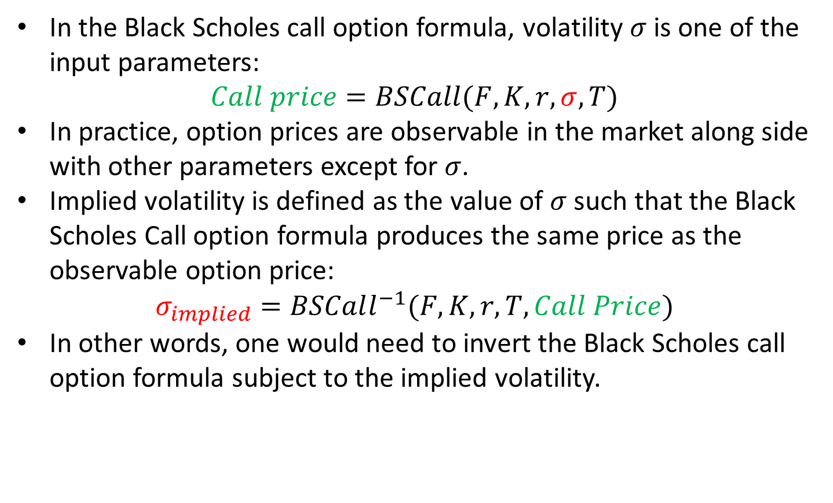
Implied volatility
In the Black Scholes call option formula, volatility $σ$ is one of the input parameters:
$$Call price=BSCall(F,K,r,σ,T)$$
In practice, option prices are observable in the market along side with other parameters except for $σ$.
Implied volatility is defined as the value of $σ$ such that the Black Scholes Call option formula produces the same price as the observable option price:
$$σ_{implied}=BSCall^{−1}(F,K,r,T,Call Price)$$
In other words, one would need to invert the Black Scholes call option formula subject to the implied volatility.

Slide 15
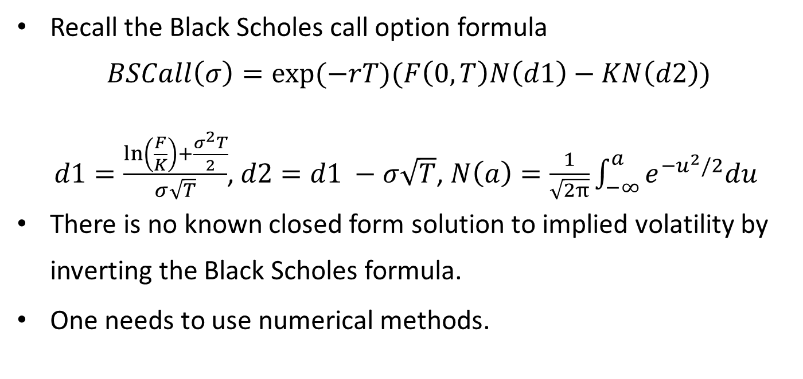
Implied volatility
Recall the Black Scholes call option formula
$$BSCall\left(σ\right)=exp⁡(−rT)(F\left(0,T\right)N\left(d1\right)−KN\left(d2\right))$$
$d1=\frac{\ln\left(\frac{F}{K}\right)+\frac{σ^{2}T}{2}}{σ\sqrt{T}}$, $d2=d1 −σ\sqrt{T}$, $N\left(a\right)=\frac{1}{\sqrt{2π}}\int_{−∞}^{a}{e^{−u^{2}/2}du}$
There is no known closed form solution to implied volatility by inverting the Black Scholes formula.
One needs to use numerical methods.

Slide 16
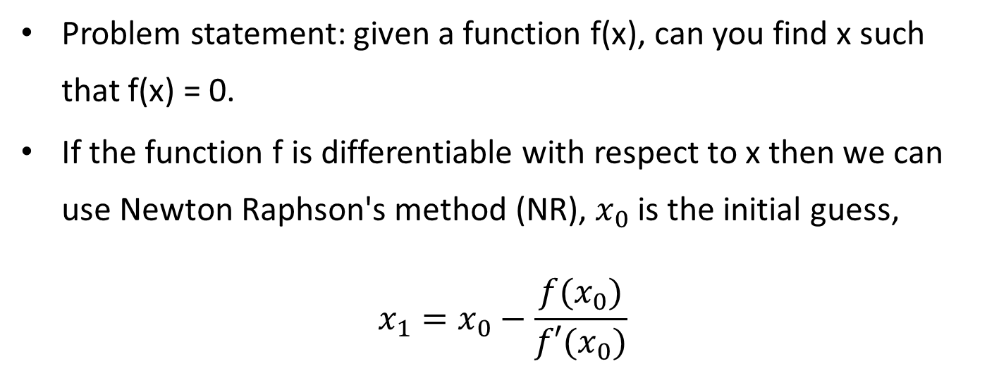
Root searching algorithm
Problem statement: given a function f(x), can you find x such that f(x) = 0.
If the function f is differentiable with respect to x then we can use Newton Raphson's method (NR), $x_{0}$ is the initial guess,
$$x_{1}=x_{0}−\frac{f(x_{0})}{f′(x_{0})}$$

Slide 17
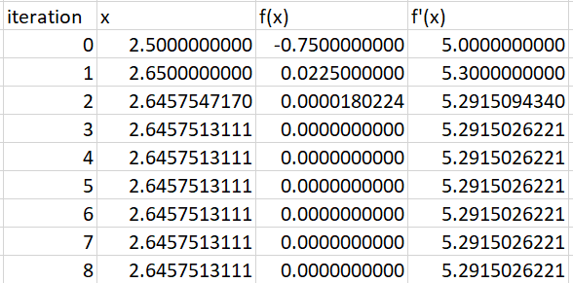
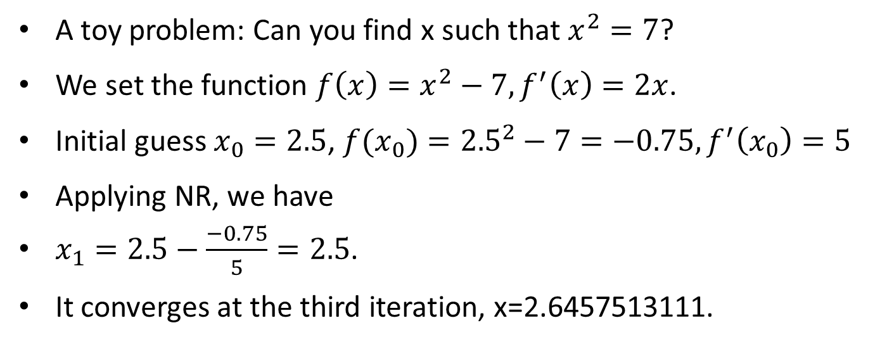
Root searching algorithm
A toy problem: Can you find x such that $x^{2}=7$?
We set the function $f\left(x\right)=x^{2}−7, f^{′}\left(x\right)=2x$.
Initial guess $x_{0}=2.5$, ${f(x}_{0})={2.5}^{2}−7=−0.75, f^{′}\left(x_{0}\right)=5$
Applying NR, we have
$x_{1}=2.5−\frac{−0.75}{5}=2.5$.
It converges at the third iteration, x=2.6457513111.

Slide 18
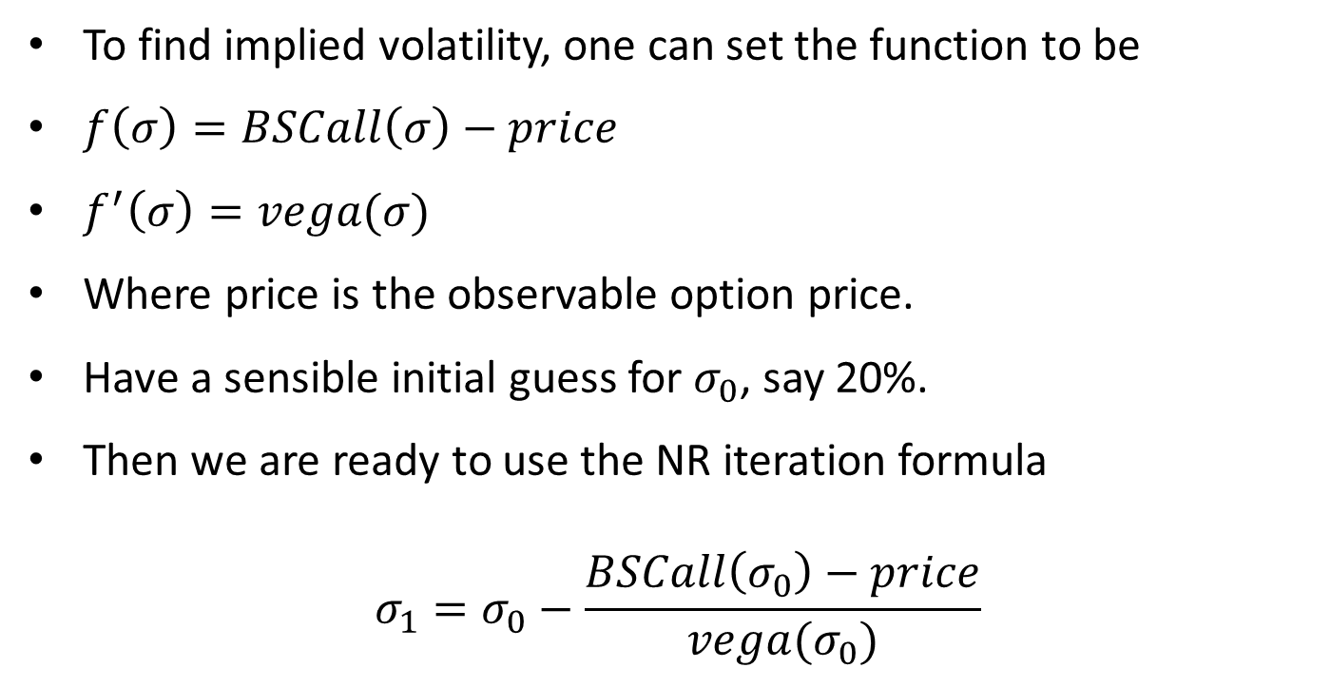
Implied Vol using NR
To find implied volatility, one can set the function to be
$f\left(σ\right)=BSCall\left(σ\right)−price$
$f^{′}\left(σ\right)=vega(σ)$
Where price is the observable option price.
Have a sensible initial guess for $σ_{0}$, say 20%.
Then we are ready to use the NR iteration formula
$$σ_{1}=σ_{0}−\frac{BSCall\left(σ_{0}\right)−price}{vega(σ_{0})}$$

Slide 19
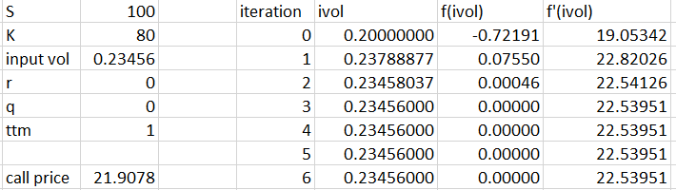
Example
The observable option price is 21.9078.
S(0)=100, K=80, r=q=0, maturity=1.
It converges after 3 iterations.

Slide 20
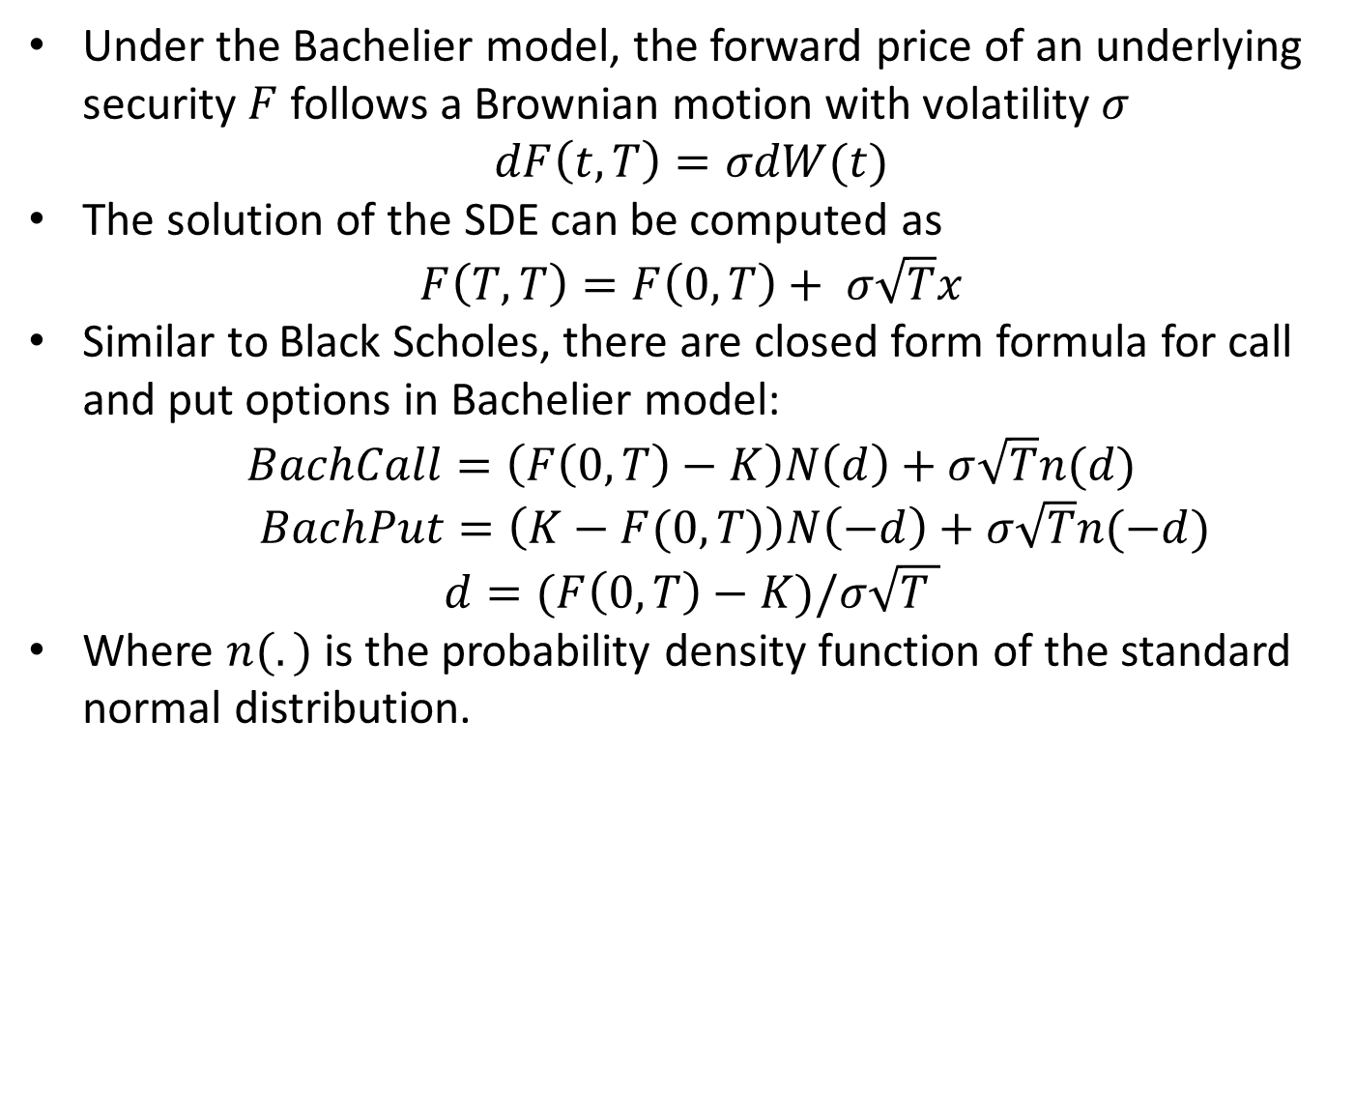
Bachelier Model
Under the Bachelier model, the forward price of an underlying security $F$ follows a Brownian motion with volatility $σ$
$$dF\left(t,T\right)=σdW(t)$$
The solution of the SDE can be computed as
$$F\left(T,T\right)=F\left(0,T\right)+ σ\sqrt{T}x$$
Similar to Black Scholes, there are closed form formula for call and put options in Bachelier model:
$$BachCall=\left(F\left(0,T\right)−K\right)N\left(d\right)+σ\sqrt{T}n(d)$$
$BachPut=\left(K−F(0,T)\right)N\left(−d\right)+σ\sqrt{T}n(−d)$
$$d=(F\left(0,T\right)−K)/σ\sqrt{T }$$
Where $n(.)$ is the probability density function of the standard normal distribution.

Slide 21
Bachelier vs Black: Implied vol skew
Consider the case that only ATM call option at a maturity is traded in the market with price P.
Forward is 2%, K is 2%, maturity is 1 year.
Assuming one trader uses Black model, the other uses Bachelier model.
Since there is only one option traded in the market, they can only calibrate to that price.
If they completely trust their models and a client ask them to quote the options with strikes at 1.5% and 2.5%. How much will they quote?

Slide 23
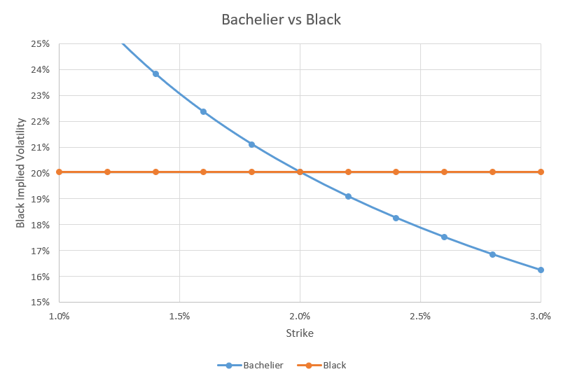
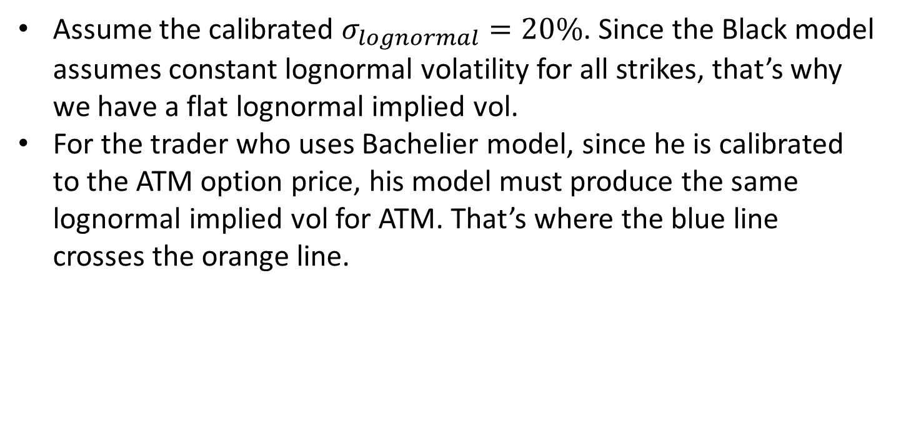
Bachelier vs Black: Implied vol skew
Assume the calibrated $σ_{lognormal}=20\%$. Since the Black model assumes constant lognormal volatility for all strikes, that’s why we have a flat lognormal implied vol.
For the trader who uses Bachelier model, since he is calibrated to the ATM option price, his model must produce the same lognormal implied vol for ATM. That’s where the blue line crosses the orange line.

Slide 24
Bachelier vs Black: Implied vol skew
But for non-ATM options, the two models will produce different option prices.
For lower strike options, Bachelier model gives higher prices than Black.
For higher strike options, Bachelier model gives lower prices than Black.

Slide 25
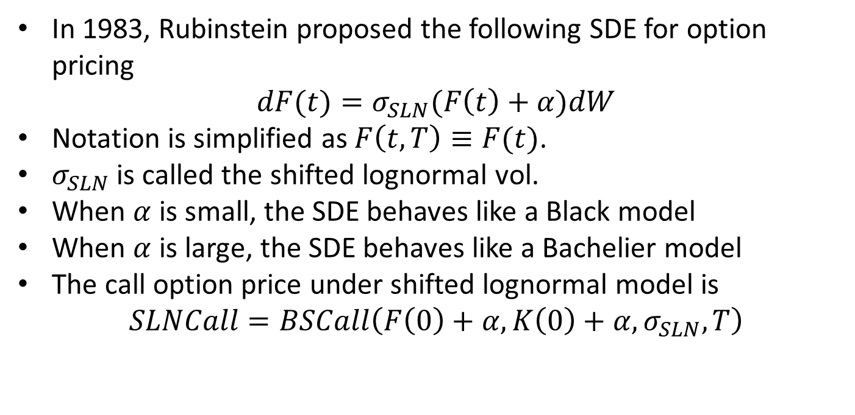
Shifted lognormal model
In 1983, Rubinstein proposed the following SDE for option pricing
$$dF(t)=σ_{SLN}(F\left(t\right)+α)dW$$
Notation is simplified as $F\left(t,T\right)≡F(t)$.
$σ_{SLN}$ is called the shifted lognormal vol.
When $α$ is small, the SDE behaves like a Black model
When $α$ is large, the SDE behaves like a Bachelier model
The call option price under shifted lognormal model is
$$SLNCall=BSCall\left(F\left(0\right)+α,K\left(0\right)+α, σ_{SLN}, T\right)$$

Slide 26
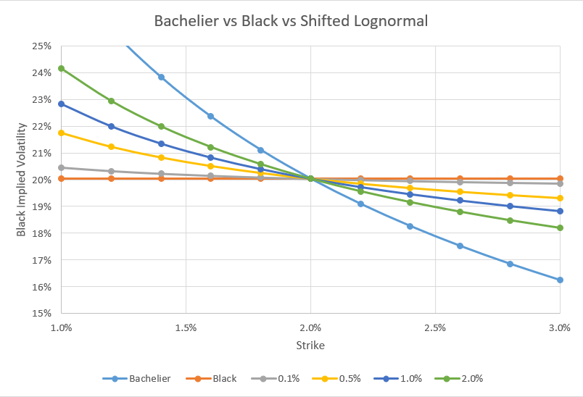
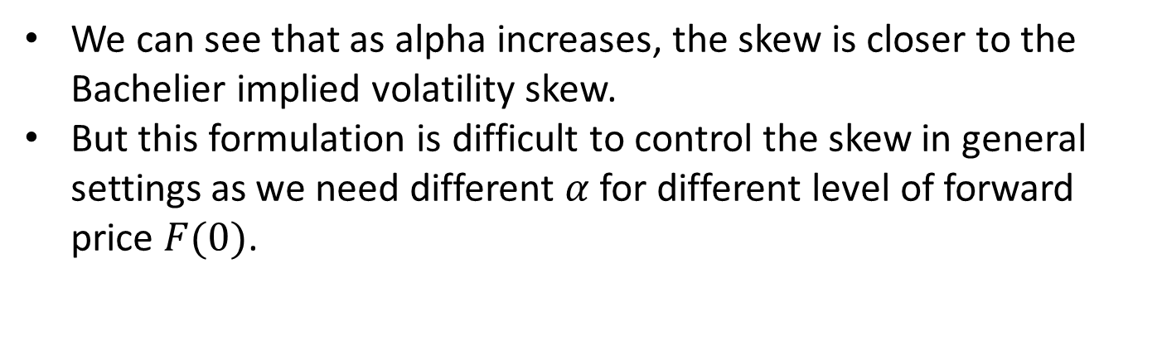
Shifted lognormal model
We can see that as alpha increases, the skew is closer to the Bachelier implied volatility skew.
But this formulation is difficult to control the skew in general settings as we need different $α$for different level of forward price $F(0)$.

Slide 27
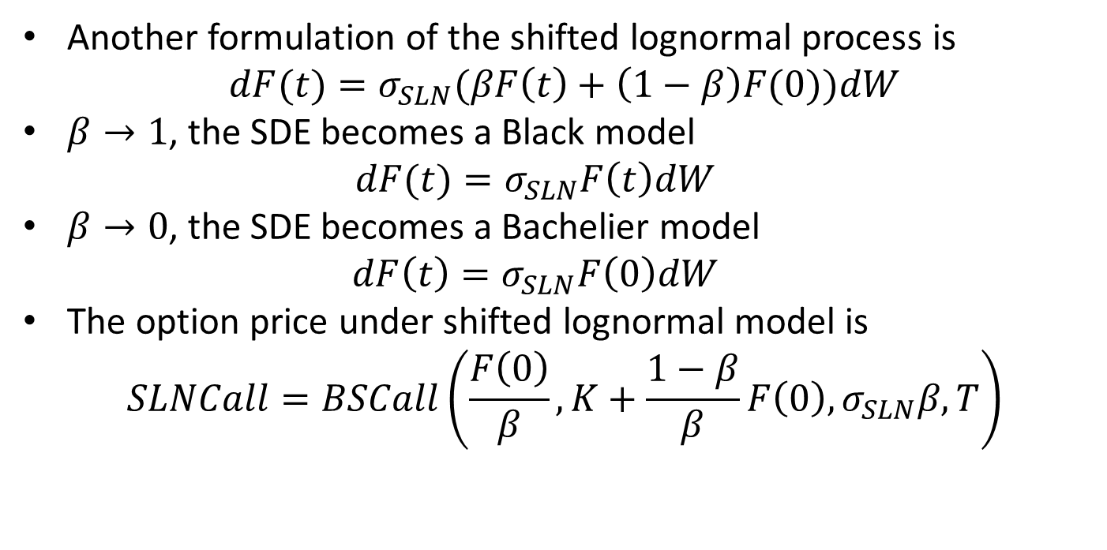
Another formulation
Another formulation of the shifted lognormal process is
$$dF(t)=σ_{SLN}(βF\left(t\right)+\left(1−β\right)F(0))dW$$
$β→1$, the SDE becomes a Black model
$$dF(t)=σ_{SLN}F\left(t\right)dW$$
$β→0$, the SDE becomes a Bachelier model
$$dF\left(t\right)=σ_{SLN}F\left(0\right)dW$$
The option price under shifted lognormal model is
$$SLNCall=BSCall\left(\frac{F\left(0\right)}{β},K+\frac{1−β}{β}F\left(0\right), σ_{SLN}β, T\right)$$

Slide 28
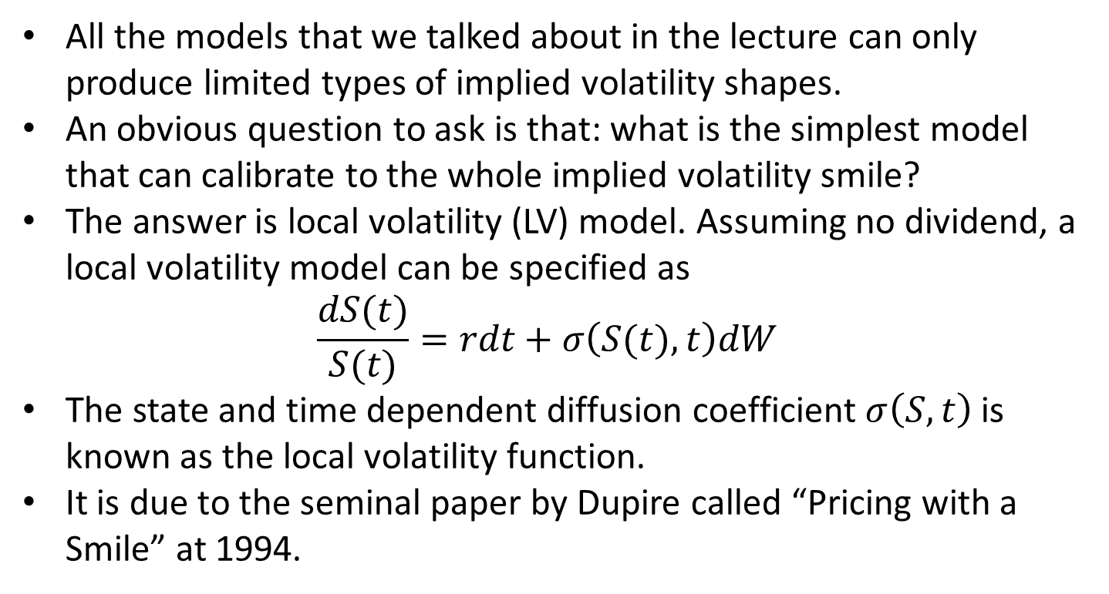
Local Volatility Model
All the models that we talked about in the lecture can only produce limited types of implied volatility shapes.
An obvious question to ask is that: what is the simplest model that can calibrate to the whole implied volatility smile?
The answer is local volatility (LV) model. Assuming no dividend, a local volatility model can be specified as
$$\frac{dS(t)}{S(t)}=rdt+σ\left(S(t), t\right)dW$$
The state and time dependent diffusion coefficient $σ\left(S,t\right)$ is known as the local volatility function.
It is due to the seminal paper by Dupire called “Pricing with a Smile” at 1994.

Slide 29
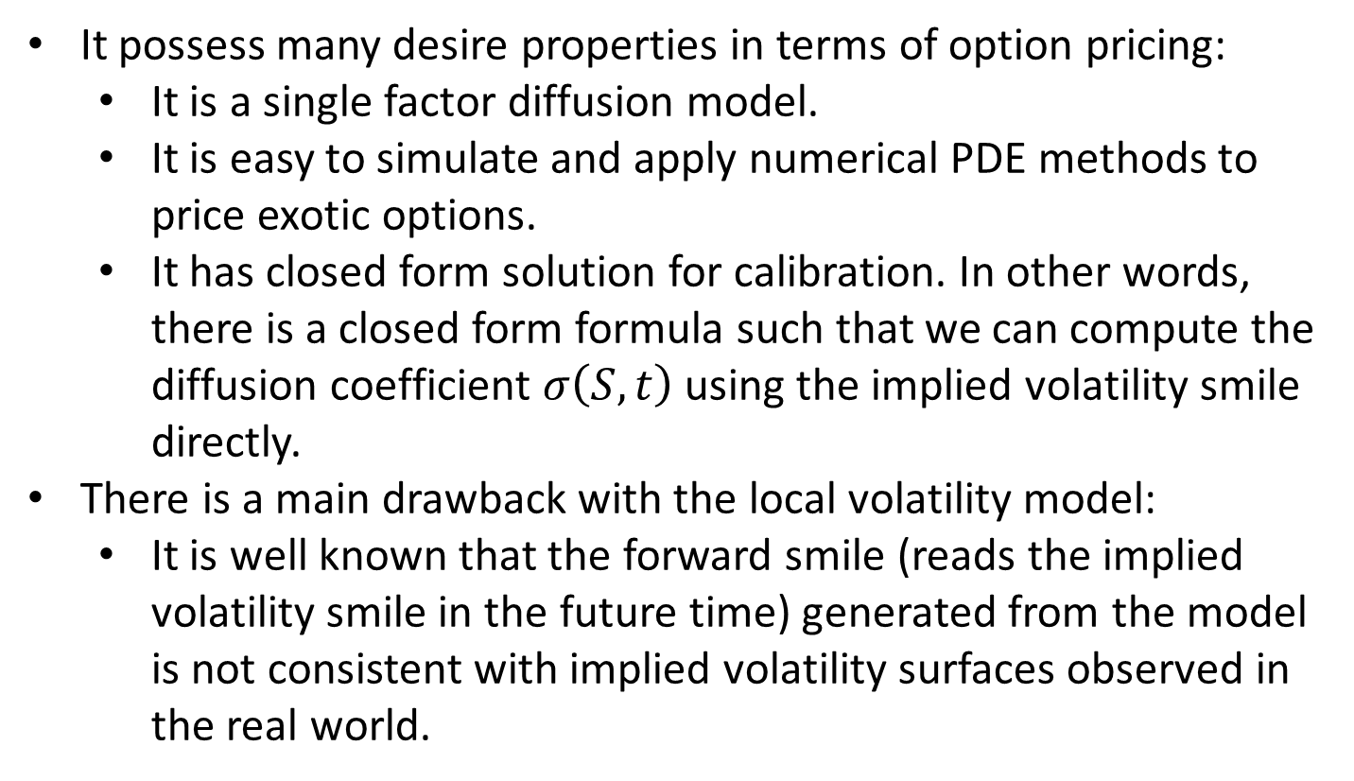
Local Volatility Model
It possess many desire properties in terms of option pricing:
It is a single factor diffusion model.
It is easy to simulate and apply numerical PDE methods to price exotic options.
It has closed form solution for calibration. In other words, there is a closed form formula such that we can compute the diffusion coefficient $σ\left(S,t\right)$ using the implied volatility smile directly.
There is a main drawback with the local volatility model:
It is well known that the forward smile (reads the implied volatility smile in the future time) generated from the model is not consistent with implied volatility surfaces observed in the real world.

Slide 30
Local Volatility Model
For FX derivatives, banks would use it to price relatively short dated exotic options (we will come back to this later).
For longer dated exotics, they are normally priced using local stochastic volatility (LSV) model.
The LSV model is an upgrade on the LV model such that the volatility is allowed to be a random process.
This allows the user to have more control on the smile dynamics.
The calibration routine is more involved.
A very good book about local volatility model is “The volatility surface” by Jim Gatheral.
Another book which contains many details on LV and LSV is “Foreign Exchange Option Pricing A Practitioners Guide” by Iain J. Clark.

